Slide 1
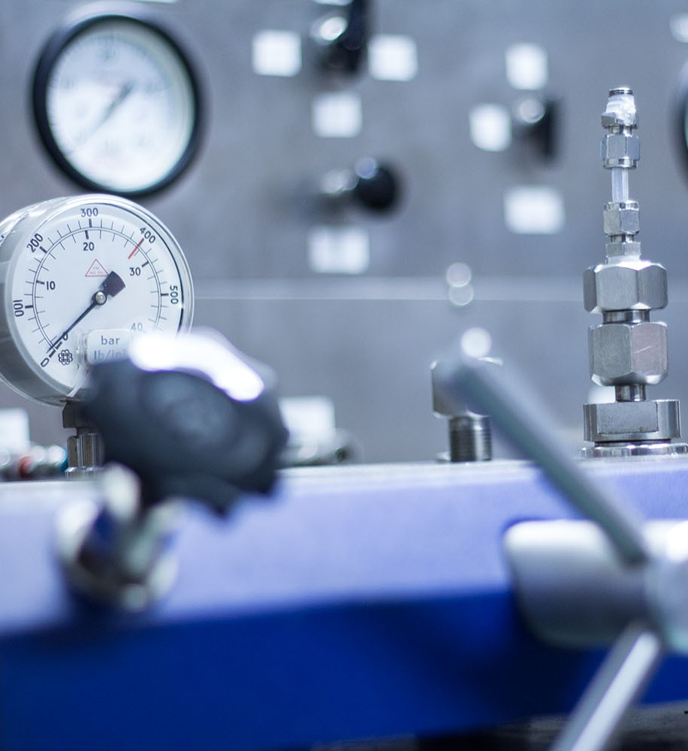





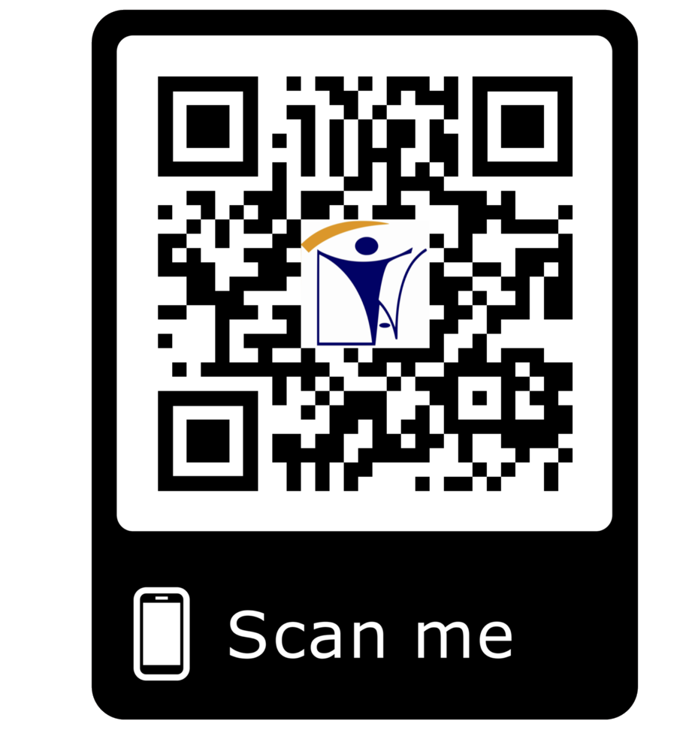







calibration@inatt.com
CALIBRATION
ISO/ IEC 17025 ACCREDITED
TEMPERATURE DEVICES
FORCE / TORQUE EQUIPMENTS
DIMENSIONAL TOOLS & EQUIPMENTS
INSTRUMENTATION EQUIPMENTS
ELECTRICAL EUIPMENTS
WELDING EQUIPMENT
PROCESS CONTROL & NDT EQUIPMENTS
PRESSURE EQUIPMENTS
PAINTING GAUGES
STANDARD REFERENCES EQUIPMENTS
GAUGES
ON SITE CALIBRATION FACILITY IN CONTAINER
PRESSURE SAFETY VALVE CALIBRATION BOTH LAB AND ONSITE
ON SITE PRESSURE SAFETY VALVE TEST FACILITY IN CONTAINER
ON SITE FLOW METER FACILITY IN CONTAINER
MECHANICAL & INSP EQUIPMENTS
WEIGHTS AND BALANCE
LIFTING EQUIPMENT & NDT INSPECTION
SURVEY EQUIPMENTS
LABORATORY EQUIPMENT
OVENS
INAT GROUP OF COMPANIES
www.inatgroupofcompanies.com Since 1974
INAT SAUDI ARABIA
INAT ENGLAND
INAT BAHRAIN
INAT EMIRATE
INAT PHILIPPINES
INAT PAKISTAN
INAT NETHERLANDS
INAT International Agent Establishment
INAT UK Multinational LTD
INAT Corporate Europe Co. W.L.L
Business Tower, Floor 8,
INAT Hanayap Services
INAT International Agent Pvt. ltd
INAT Overseas Company B.V.
PO Box 30060, Al Khobar 31952
46 Cameron Road
Office 1309, Sitra Mall, Bldg No. 574,
Office # 811
Blk 30. Lot 16,
283 Zeenat Block,
Gustav Mahlerplein 2,
1/3
Eastern Province,
Ilford, Essex IG3 8LF
Road 31, Block 611.
Business Bay, Dubai,
Magdalene Ville 2, Bacolod City
Alama Iqbal Town, Lahore,
1082 MA, Amsterdam
Kingdom of Saudi Arabia info@inatt.com
United Kingdom info@inatukmultinational.com
Kingdom of Bahrain info@inatcorporateeurope.com
United Arab Emirates info@inatemirates.com
Philippines info@inatpacificasia.com
Islamic Republic of Pakistan info@inatpakistan.com
The Netherlands info@inatoverseascompany.com

Slide 2
INAT GROUP ISO 17025 Accredited Calibration Laboratory offering Services to ensure that the equipment installed or accessories used in Oil & Gas, chemical Industries, refinery or plants checked regularly after some interval to verify its operation by meeting compliance standards, specification and regulatory requirements , scope of which includes
FORCE / TORQUE
Torque Calibrators
Torque Wrenches
PROCESS CONTROL INSTRUMENTIATION
Pressure Transmitters
Tension Gauges
Compression Machines
Tensile Testing Machines
Hydraulic Jacks
Temperature Transmitters
Multi gas Detectors
Anemometers
Tachometers
Torque Gauges
Level Transmitters
Load Cells
Flow Transmitters
Densitometers
Force Gauges
Volumetric Measurements
Hydrotesting Facilities
Universal Testing machines up to 60T on capacity
ELECTRICAL / ELECTRONICS
Auto Label
Safety Relief Valves
I/P Converters
Tension & Accessory Calibrators
LIFTING EQUIPMENT AND NON-DESTRUCTIVE EQUIPMENT INSPECTION AND CALIBRATION
PMI Equipment
Digital
Analogue multimeters
Frequency meters
Volt meters
Power supplies
Digital Earth Testers
High Voltage Porosity
Crane Certifications
Clamp meters
JIB Cranes Calibration
Insulation testers
Earth resistance testers
Ultrasonic Flow Detectors
Lux Meters
Hardness Testers
MPT Yokes
Stop Watches
Sound Level Meters
Ohm meters
Ampere meters
High voltage testers
PRESSURE
Pressure Elements
Pressure Transmitters
Detectors
Megger Testers
MECHANICAL & INSPECTION EQUIPMENT
Inspection Tools
Pressure Recorders
Hydraulic
Pneumatic & Vacuum
Mechanical Testing
Profile Gauges
Pressure Gauges
Equipment
Gauge Block Sets
Pressure Safety Valves
Manometers
Pumps
Mechanical Measuring
Slip Gauges
Others
Digital Pressure Indicators
Air Compressors
Equipment
Pressure Testing Facilities
WEIGHTS
Weighing Scales
Balances`
GAUGE CALIBRATION (DIAL & DIGITAL)
Specific Gravity Gauges
Load Gauges Calibration
Top Loads
Pressure Calibration
Dead Weights
Other type of Balance``
Dial Gauge Indicators
Digital Gauge Indicators
Others
STANDARD REFERENCE CALIBRATION
TEMPERATURE
Temperature gauges
Surface Temperature
Temperature Calibrators
Thermocouples
Thermocouple Ni-Cr-Nil
RTD
Temperature Recorders
Process Calibrators
Temperature Elements
Dial Indicator Thermometers
Load Cells
Dead Weight Testers
Pressure Calibrators
Multi Calibrators
gauges
Digital Thermometers
Glass Thermometer
Micro Processor
Test Gauges
Power Supply 24 VDC
Temperature Baths
Digital Multimeters
Decade Resistance
Clamp Meters
Thermometers
Thermometer
Hygrometers
Humidity Calibration
Humidity Recorders
Boxes
Temperature Calibrators
Set of Instrument Tools and Fittings

Slide 3
DIMENSIONAL CALIBRATION
OVENS
Electric Ovens
Holding Ovens
Digital Micrometers
Digital Vernier Caliper
Manual Vernier Caliper
Digital Millimeters
Angle Protractors
200mm
Laser Range Meter
Burners
Master Level
Incubators
Desiccators
Measuring Tapes
Dial Indicators
Meters
Distance Meters
Others
WELDING EQUIPMENT CALIBRATION
Welding Machines
Reference Clamps for Welding Machine
SURVEY METER
Theodolite
Auto Level
Other Surveying Equipment Calibration
Welding Inspection Gauges
Total Station
Others
PAINTING GAUGES
Digital Coating Gauges
Dial Coating Gauges
LABORATORY TESTING & BATCH PLANTS
Nuclear Density Gauges for Compaction Test
Electrical Density Gauge
Digital Micrometers
Concrete Batch Plants
Dew Point Painting Gauges
Surface profile Gauges
Asphalt Plants
Holiday Detectors
Pin Hole Detectors
Others
All Laboratory Standard Equipment
Chemical Testing Equipment's (PH Meters, TDS Meters, Hydrometers, spectrophotometers & Other Equipment's)
Civil Testing Laboratory Equipment
ON SITE CALIBRATION FACILITY IN CONTAINER
INAT capable to provide site services by our Mobile Calibration & repairing on project sites to avoid the delay in process. Mobile calibration services provide premium service with maximum convenience, with mobile labs located throughout the KSA . Our ISO 17025 accredited mobile calibration laboratories offer a wide range of calibration capabilities including the Pressure, Torque, Temperature, Hydraulics, and Electrical measurement disciplines. trailer comes equipped with an inventory of test & measurement equipment available.
PRESSURE SAFETY VALVE CALIBRATION BOTH LAB AND ONSITE
Bellows safety valve, Diaphragm safety valve, Proportional safety valve , Pilot operated pressure relief valve , Balanced safety relief valve, Conventional safety relief valve and other type of valves,
ON SITE PRESSURE SAFETY VALVE TEST FACILITY IN CONTAINER
INAT capable to provide Remote Lab site services for pressure safety Calibration & repairing on project sites or INAT can shift Mobile container equipment with safety relief valve testing to avoid the delay in process, saving cost of transportation to laboratory
ON SITE FLOW METER FACILITY IN CONTAINER
INAT provides flow meter calibration services.
flow meter instruments ensure that the flow meter's measurements are as accurate as their specifications.
Our comprehensive flow meter calibration services can be custom-tailored to meet your specific requirements either at your site or through our mobile lab.

