Slide 1








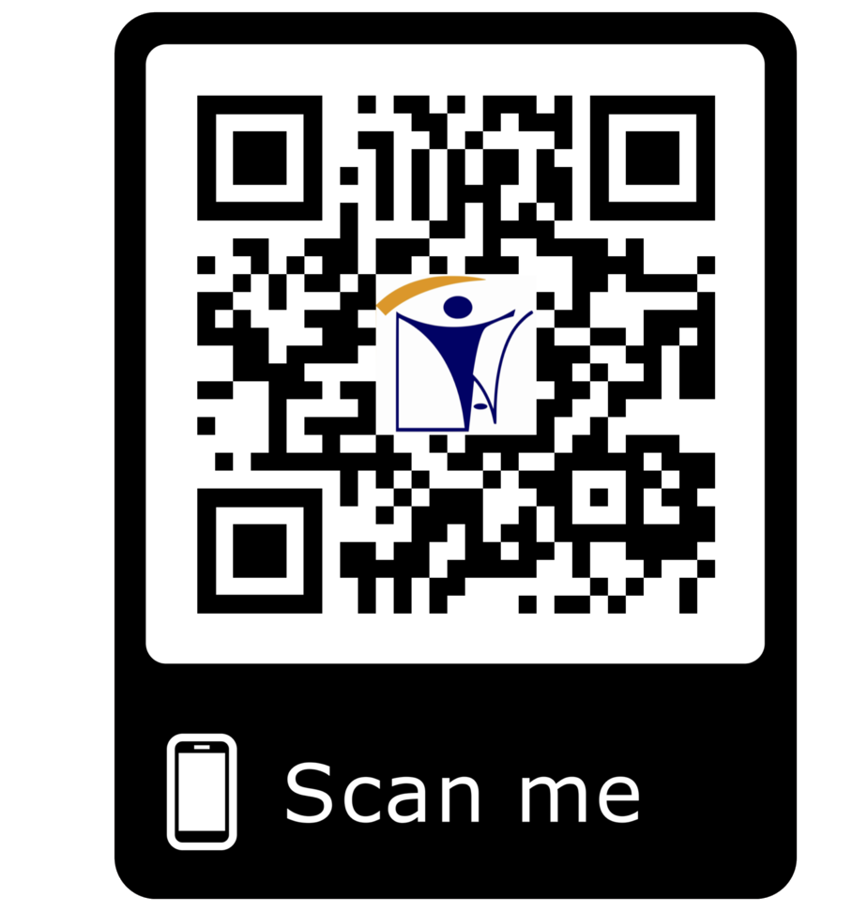







certification@inatt.com ISO 17021-1 Accredited
CERTIFICATION
CERTIFICATION PROGRAMS
AUDIT
INAT GROUP OF COMPANIES
www.inatgroupofcompanies.com Since 1974
INAT SAUDI ARABIA
INAT ENGLAND
INAT BAHRAIN
INAT EMIRATE
INAT PHILIPPINES
INAT PAKISTAN
INAT NETHERLANDS
INAT International Agent Establishment
INAT UK Multinational LTD
INAT Corporate Europe Co. W.L.L
Business Tower, Floor 8,
INAT Hanayap Services
INAT International Agent Pvt. ltd
INAT Overseas Company B.V.
1/2
PO Box 30060, Al Khobar 31952
46 Cameron Road
Office 1309, Sitra Mall, Bldg No. 574,
Office # 811
Blk 30. Lot 16,
283 Zeenat Block,
Gustav Mahlerplein 2,
Eastern Province,
Ilford, Essex IG3 8LF
Road 31, Block 611.
Business Bay, Dubai,
Magdalene Ville 2, Bacolod City
Alama Iqbal Town, Lahore,
1082 MA, Amsterdam
Kingdom of Saudi Arabia info@inatt.com
United Kingdom info@inatukmultinational.com
Kingdom of Bahrain info@inatcorporateeurope.com
United Arab Emirates info@inatemirates.com
Philippines info@inatpacificasia.com
Islamic Republic of Pakistan info@inatpakistan.com
The Netherlands info@inatoverseascompany.com

Slide 2
CERTIFICATION PROGRAM
INAT Group provides Certification program.
Its main operation subject is certification of management systems (quality, environment, occupational health and safety protection, information security, food safety, supplier, etc.) and provision of other services.
Our certification scope includes:
ISO 9001:2015 Quality Management system (QMS) Certification
ISO 14001:2015 Environment Management System (EMS) Certification
ISO 4500:2018 Occupational Health and Safety Management Systems Certification
ISO 22000: 2018 Food Safety Management Systems Certification
ISO 27001:2013 Information Security Management Systems (ISMS) Certification
ISO 50001:2018 Energy Management Systems Certification,
ISO 22301:2012 Business Continuity Management System
ISO 37001: 2016 Certification (Anti Bribery Management Systems)
AUDITS
INAT is specialize in Performing First Party, 2nd Party and Third-Party Audit for all type of Industries Especially Oil and Gas Industry, Chemical Industries, Laboratories, Aerospace, Agriculture, Automotive Industry, Energy & Solar Industry, Food Industry, IT and Construction Industry from design stage to project construction till completion or plant or warehouse or facilities:
Design Phase Audit
Procurement Phase Audit
Construction Phase Audit
Health and Safety Audit
Civil, Mechanical, E & I Laboratory Audit
NDT, Calibration Laboratory Audit,
Onsite Fabrication Facility Audit
Manufacturer Facility Audit
Performance Audit
Vendor Surveillance Assessment and Technical Audit
Risk Assessment Audit
EMS Audit,
ISMS Audit
Energy Management System Audit
Food Safety Management System Audit
Gap Analysis, Preventive Measures and Suggestion for Improvement in Total Quality Management System.
2/2

