Slide 1




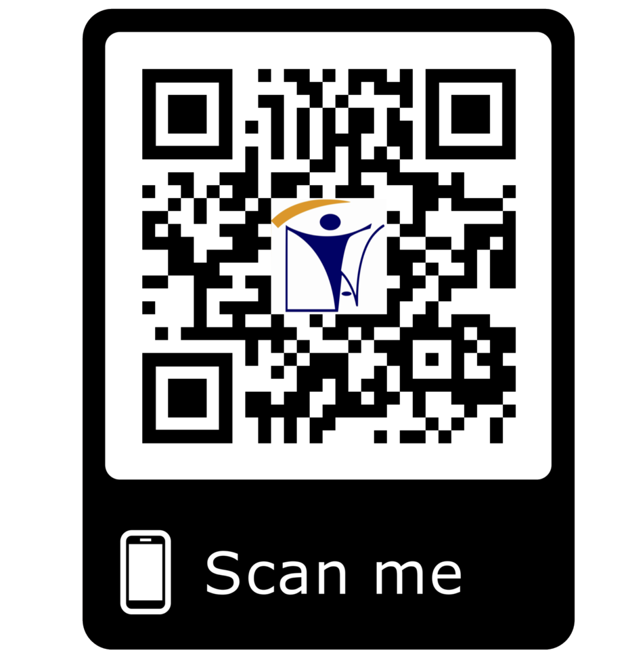







_{C}co_{O}nt_{N}rac_{T}ti_{R}ng_{A}@_{C}ina_{T}tt_{I}._{N}com_{G}
PROJECT SITE SURVEY
PROJECT MANAGEMENT TEAM
FACILITIES AND EQUIPMENT
HIGHLY SKILLED MANPPOWER
INAT GROUP OF COMPANIES
www.inatgroupofcompanies.com Since 1974
INAT SAUDI ARABIA
INAT ENGLAND
INAT BAHRAIN
INAT EMIRATE
INAT PHILIPPINES
INAT PAKISTAN
INAT NETHERLANDS
INAT International Agent Establishment
INAT UK Multinational LTD
INAT Corporate Europe Co. W.L.L
Business Tower, Floor 8,
INAT Hanayap Services
INAT International Agent Pvt. ltd
INAT Overseas Company B.V.
1/2
PO Box 30060, Al Khobar 31952
46 Cameron Road
Office 1309, Sitra Mall, Bldg No. 574,
Office # 811
Blk 30. Lot 16,
283 Zeenat Block,
Gustav Mahlerplein 2,
Eastern Province,
Ilford, Essex IG3 8LF
Road 31, Block 611.
Business Bay, Dubai,
Magdalene Ville 2, Bacolod City
Alama Iqbal Town, Lahore,
1082 MA, Amsterdam
Kingdom of Saudi Arabia info@inatt.com
United Kingdom info@inatukmultinational.com
Kingdom of Bahrain info@inatcorporateeurope.com
United Arab Emirates info@inatemirates.com
Philippines info@inatpacificasia.com
Islamic Republic of Pakistan info@inatpakistan.com
The Netherlands info@inatoverseascompany.com

Slide 2
INAT will completely bid your project to provide a full spectrum of services to manager the actual construction process. Our proactive and adaptive approach ensures that projects run efficiently, on schedule and on budget every time. INAT is responsible for providing all material, equipment and labor needed during construction for buildings, real estates, government sectors projects and private developers.
Construction
Value Engineering
Project Scheduling
Surveying & Materials Testing
Phase
Project Close-Out
Owner Occupancy
Including Inspection
Onsite Supervision
PROJECT SITE SURVEY
Our resourceful survey team throughout Saudi Arabia are highly qualified to take necessary information at early stage of the project. This will give Project Management team concrete details in preparation for planning and real schedule forecast of execution.
PROJECT MANAGEMENT TEAM
We provide outstanding Specialized Project Management team applied to specific projects. From planning stage through the execution phases for the purpose of achieving common project objectives, including project safety, quality management, cost, time, and project completion.
FACILITIES AND EQUIPMENT
To execute projects on time we have sources of reliable equipment and machines such as heavy equipment, Loaders, Cranes, Compactors, Excavators, Motor Graders, boom lifts, man-lifts, man-cages, welding machines and scaffolding. We operate projects with presence of full time Safety officer to ensure zero-accident workplace.
HIGHLY SKILLED MANPPOWER
We offer highly skilled manpower on site to guarantee project completion on
time. We have flexible team like that will provide expertise in contracting filed and to expedite the project in timely manner.
2/2

