Slide 1
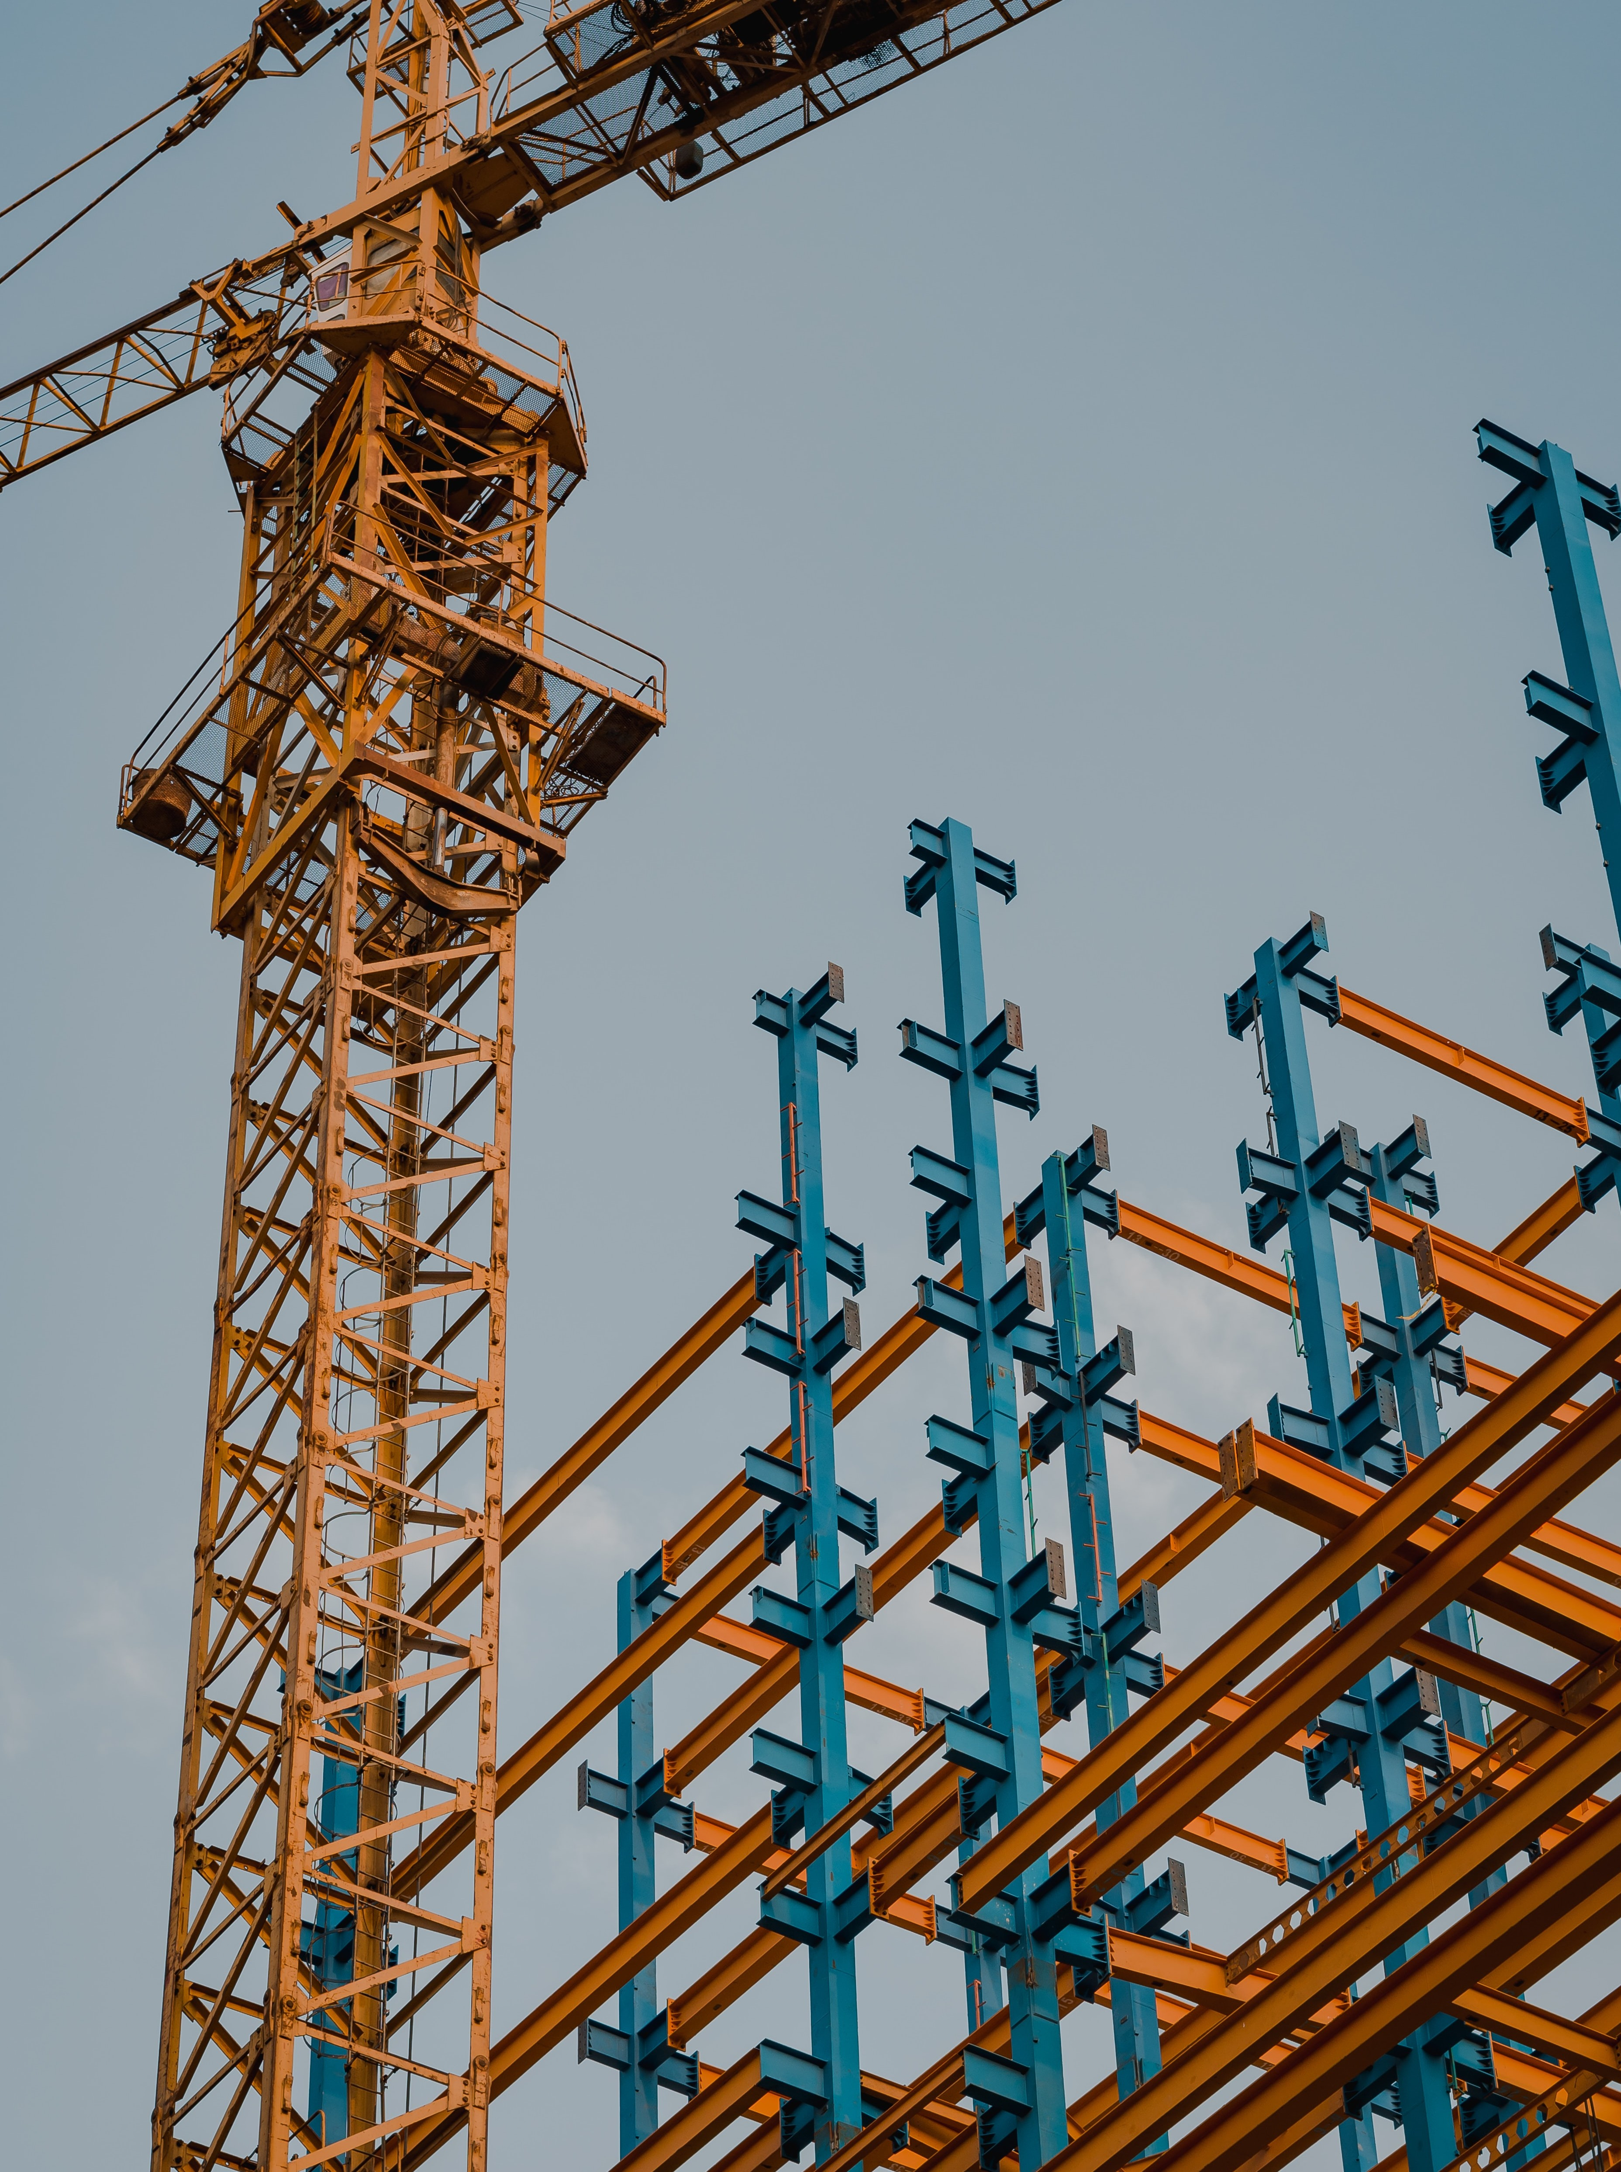




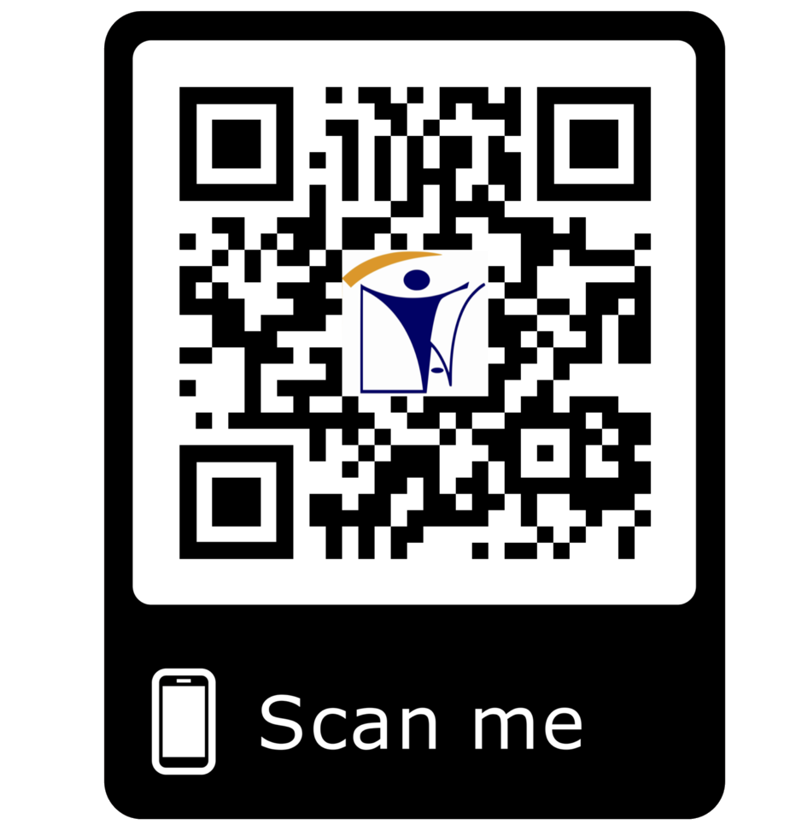







er_{E}ec_{R}ti_{E}on_{C}@_{T}in_{I}a_{O}tt.c_{N}om
PROJECT SITE SURVEY
ERECTION PROJECT MANAGEMENT TEAM
ERECETION FACILITIES AND EQUIPMENT
HIGHLY SKILLED MANPPOWER
INAT GROUP OF COMPANIES
www.inatgroupofcompanies.com Since 1974
INAT SAUDI ARABIA
INAT ENGLAND
INAT BAHRAIN
INAT EMIRATE
INAT PHILIPPINES
INAT PAKISTAN
INAT NETHERLANDS
INAT International Agent Establishment
INAT UK Multinational LTD
INAT Corporate Europe Co. W.L.L
Business Tower, Floor 8,
INAT Hanayap Services
INAT International Agent Pvt. ltd
INAT Overseas Company B.V.
PO Box 30060, Al Khobar 31952
46 Cameron Road
Office 1309, Sitra Mall, Bldg No. 574,
Office # 811
Blk 30. Lot 16,
283 Zeenat Block,
Gustav Mahlerplein 2,
1/2
Eastern Province,
Ilford, Essex IG3 8LF
Road 31, Block 611.
Business Bay, Dubai,
Magdalene Ville 2, Bacolod City
Alama Iqbal Town, Lahore,
1082 MA, Amsterdam
Kingdom of Saudi Arabia info@inatt.com
United Kingdom info@inatukmultinational.com
Kingdom of Bahrain info@inatcorporateeurope.com
United Arab Emirates info@inatemirates.com
Philippines info@inatpacificasia.com
Islamic Republic of Pakistan info@inatpakistan.com
The Netherlands info@inatoverseascompany.com

Slide 2
INAT Group develop a highly qualified and reliable experience team for ASSEMBLY & ERECTION of the following:
Support Structure
Mechanical Structures
T-BOX/ Elbow
Expansion Joints
Transition Ducts
Exhaust Stacks
Our range of services includes:
Project Site Survey
Our resourceful survey team throughout Saudi Arabia are highly qualified to
take necessary information at early stage of the project. This will give Project Management team concrete details in preparation for planning and real schedule forecast of execution.
Erection Project Management Team
We provide outstanding Specialized Erection Project Management team applied to specific erection projects. From planning stage through the execution phases for the purpose of achieving common project objectives, including project safety, quality management, cost, time, and project completion.
Erection Facilities & Equipment
To execute projects on time we have sources of reliable equipment and machines such as cranes, boom lifts, man-lifts, man-cages, welding machines and scaffolding. We operate projects with presence of full time Safety officer to ensure zero-accident workplace.
Highly Skilled Manpower
We offer highly skilled manpower on site to guarantee project completion on time. We have flexible team like Mechanical QA/QC Supervisor, Project Safety Officers, Welding Supervisors, Rigging Supervisor, Cladding Supervisor and Scaffolding Supervisor. We can provide highly skilled Welders, Riggers, Fitters, Fabricators, Cladders and Scaffolders.
2/2

