Slide 1





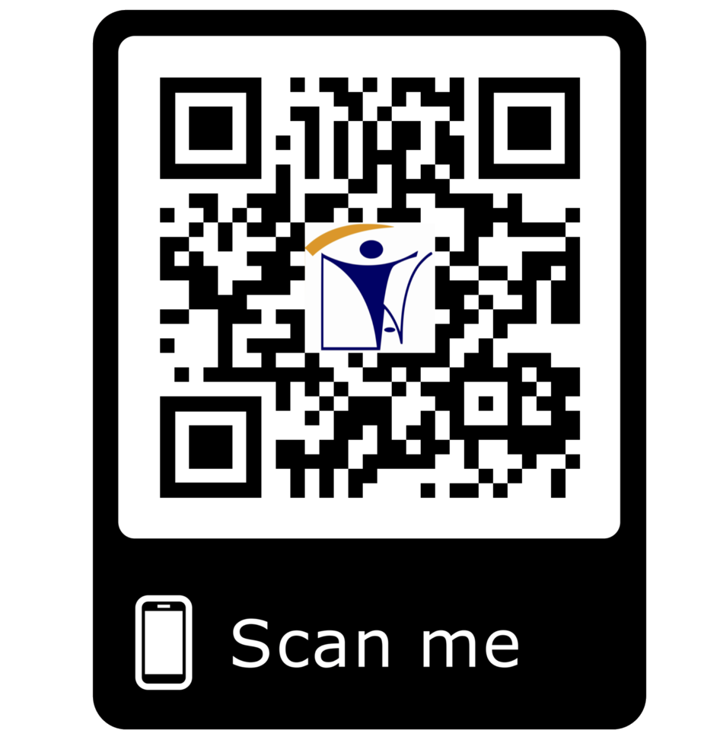







Inspecting, Assessing and Monitoring the World
i_{I}n_{N}spe_{S}ct_{P}io_{E}n@_{C}i_{T}na_{I}t_{O}t.c_{N}om
Vendor Quality Surveillance/ Third Party Vendor Inspection/ Material Inspection
Management System Certification Body
Audit & Process Improvement Support
In Services Inspection & Other Inspection
Railway Component and Equipment Inspection
Painting and Coating Procedure Qualification and Failure Assessment , Cathodic Protection
Welding Procedure and Welder Qualification
Project Support Services
Technical Consultancy Training
17020 Accredited
INAT GROUP OF COMPANIES
www.inatgroupofcompanies.com Since 1974
INAT SAUDI ARABIA
INAT ENGLAND
INAT BAHRAIN
INAT EMIRATE
INAT PHILIPPINES
INAT PAKISTAN
INAT NETHERLANDS
INAT International Agent Establishment
INAT UK Multinational LTD
INAT Corporate Europe Co. W.L.L
Business Tower, Floor 8,
INAT Hanayap Services
INAT International Agent Pvt. ltd
INAT Overseas Company B.V.
PO Box 30060, Al Khobar 31952
46 Cameron Road
Office 1309, Sitra Mall, Bldg No. 574,
Office # 811
Blk 30. Lot 16,
283 Zeenat Block,
Gustav Mahlerplein 2,
1/4
Eastern Province,
Ilford, Essex IG3 8LF
Road 31, Block 611.
Business Bay, Dubai,
Magdalene Ville 2, Bacolod City
Alama Iqbal Town, Lahore,
1082 MA, Amsterdam
Kingdom of Saudi Arabia info@inatt.com
United Kingdom info@inatukmultinational.com
Kingdom of Bahrain info@inatcorporateeurope.com
United Arab Emirates info@inatemirates.com
Philippines info@inatpacificasia.com
Islamic Republic of Pakistan info@inatpakistan.com
The Netherlands info@inatoverseascompany.com

Slide 2
VENDOR QUALITY SURVEILLANCE / THIRD PARTY VENDOR INSPECTION / MATERIAL INSPECTION
“INAT” Inspection Services offers comprehensive Vendor Quality Assurance services, ensuring that the quality level of material and equipment provided to our customer meets all the defined requirements.
An organized and properly implemented vendor quality assurance program can be cost effective in assuming that a project will not be delayed or shutdown due to deficiencies in the quality of materials or equipment supplied.
“INAT” Vendor Quality Assurance Representatives are qualified by the company and they are certified by Internationally recognized organizations such as TWI, ASNT, API, AWS and ASQC. The service aims to control at the premises of the manufacturer or sub-contractor, the quality of workmanship and the conformity of the manufactured equipment with the purchase specifications, the applicable drawings, codes and standards and other relevant contractual documents. The level of “INAT” involvement will be identified in an Inspection and Test Plan.
Mechanical (Vendor Manufacturer Inspection and Assessment)
Pressure Vessels as per API 510, Steel Tank Inspections as per API 650, Piping Inspection as per API 570, Pipes/ Fittings/ Flanges as per ASTM A234/ API 5L/ ASTM A53/ ASTM A106/ ASTM A105/ ASTM A350, Valves as per API 600, 602,598, 6D, Steel plates,
Structural steel as per AWS D.1.1, Rotary Equipment, Pumps, Compressors, Turbines, Generators, RTR Pipes, Fiber Glass Tanks, Studs,/
Bolts/ Nuts/ Washers, Steel Doors, Frames and others.
Electrical and Instrument (Vendor/ Manufacturer Inspection & Assessment)
Wires and Cables, Conduits, RSG, PVC, Transformers, Switch Gears, Switch Racks, Panel Boards, Control Systems, Fire Fighting System, Security Systems CCTV, Paging Systems/ Fence Intrusion Systems, Electrical fixtures, Lighting Poles, UPS System, Cathodic Protection and others.
Civil Vendor Inspection
Aluminum Doors and Windows, Blast Doors, Pre-cast Concrete, Chain Link Fence, Hollow Metal Doors, Frames and Hardware, Structural Steel Works, Anchor Bolts, Batching Plants, Concrete Mix Design, Asphalt Mix Design and others.
Quality Procurement
Supervision of procurement material, preparation of Inspection and Quality Requirement for material as per client’s specifications and standards
Expediters
Expediting enables the site construction work to proceed as scheduled and helps to minimize delays and costly product deficiency issues.
Our Expediters are experienced in utilizing specification criteria defined by International Standards and Client Specifications.
MANAGEMENT SYSTEM CERTIFICATION BODY
ISO 9001:2015 Certification (Quality Management System)
ISO 14001:2015 Certification (Environmental Management System)
ISO 45001:2018 Certification (Occupational Health & Safety Management System)
ISO 22000:2018 Certification (Food Safety Management System)
ISO 27001:2013 Certification (Information Security Management System)
ISO 5001:2018 Certification (Energy Management Systems)
ISO 37001: 2016 Certification (Anti Bribery Management Systems)
AUDIT & PROCESS IMPROVEMENT SUPPORT
Construction, Procurement and Design Audit
Third Party Pre-Assessments and Surveillance Audit
First, Second and Third Party Audits
Vendor Surveillance Assessment/ Audit
QMS Audits
Manufacturer Facility Audit
Performance Audit
Preventive Measures and Improvement in Total Quality Management System
Developing Skills for Quality Managers
Process Design and Improvement
Preparation and Implementation of Flow Chart and Statistical Analysis Techniques
2/4

Slide 3
IN SERVICE INSPECTION & OTHER INSPECTION
Equipment can break down at any time when it is in service, which can lead to delays in production, increasing costs and liability. To prevent these situations from occurring, it is important to schedule inspections regularly. This will ensure that the equipment has been installed, operated, and maintained properly under the watch of a qualified inspector.
Our In-service inspection is more effective for maintenance inspections, performance verification and preventive failure analyses to maximize productivity and reduce costly downtime and meet safety, compliance standards, specification and regulatory requirements which includes:
In-Plant Inspections
Plant integrity, safety & reliability are major concerns to all plant operators and managers. The challenge to management is to ensure
that their assets are in a fit-for-service condition, complying with regulatory and company requirements in the most reliable, safe and cost-effective manner, our in-plant services assist our clients to achieve this. Our in-plant inspections are performed using a RBI methodology following API 580 and API 581 principles. Supplemented by API 570, API 510 and API 653 codes, we inspect the following elements: Tanks, Piping, Pipelines, Pressure Vessels, Heat Exchangers, Coolers, Structures, etc.
Pipeline Integrity Inspection Service
Pipelines are critical business assets, their integrity, safety & reliability are major concerns to pipeline operators and owners. Our pipeline integrity inspection service which is based on API 1163 and ASME 31.8S, enables us to assist our clients to ensure that their
assets are in a fit-for-service condition and comply with regulatory requirements. We are able to provide this service with minimum or no disruption to pipeline operations.
Tank Inspection Services
We perform aboveground storage tank inspections in the petroleum and chemical industries. Our tank inspection services assist our clients in maintaining the integrity of their tanks, through enhancing safety, protecting the environment and making sure their assets are fit-for- purpose. We perform comprehensive tank inspections, which meet and exceed, the requirements established in API 650/653 codes.
Risk Based Inspection (RBI) Services
RBI is a method for using risk as a basis to prioritize and manage the efforts of an inspection program, based on the consequences of
failure of components and systems. It helps to ensure that facilities are fit-for-purpose, the protection of the environment, the safety of personnel and avoid costly unplanned shutdowns.
Crane Inspection and Inspection of Hoisting and Lifting Equipment
Our Inspection ensures the safety and reliability of Crane, hoisting and lifting equipment and compliance with statutory requirements. It is require to ensure that they are safe, and in compliance with statutory requirements.
Failure Analysis and Investigation
Our Service includes the root cause failure analysis, testing of metal products makes use of macroscopic and microscopic examination methods, as well as other investigative tools such as nondestructive testing, mechanical testing and chemical analysis. The failure analysis investigation concentrates on the metallurgical aspects of the failure. They generally do not emphasize factors such as stress or load distributions.
Technical Assistance and Inspection during Shutdown
Our effective inspection and technical assistance during turnarounds enables to decrease costly downtime and re-start operations as quickly and as safely as possible.
RAILWAY COMPONENT AND EQUIPMENT INSPECTION
“INAT” with experienced staff is providing Quality Assurance Services Associated with the procurement of Stock Rail, our qualified representatives are extremely well educated in the applicable inspection codes such as American Welding Society (AWS) D!.1 and D!.5; AASHTO; ASTM Standards E10, E142m E164 and E709; AISI; and SSPC with specific knowledge in Manual for Railway Engineering, “ Specifications for Steel Rail; Fabrication of Continuous Rail, Thermite Welding,
Our Inspectors monitor the production process, non destructive weld evaluations, dimensional analysis reviews and coating inspections. In– service inspections include damage verification, post repair as well as repair shop assessment and evaluations to reduce non-physical errors in the fabrication process. Inspections during the fabrication of Special Track work including Turnouts and their components such as: Switch Points, Frogs, Guard Rails, Tie Plated, Gauge Rod, and Concrete and
Timber Ties.
3/4

Slide 4
PAINTING AND COATING PROCEDURE QUALIFICATION AND FAILURE ASSESSMENT
INAT provides a coating inspection service to the engineering industry both On shore and Off Shore, we also act as third party inspector on client’s behalf. Our capability includes application Testing and Inspection as well as routine condition monitoring of rubber, bitumen PE, glass, paint coated surfaces and failure assessment.
WELDING PROCEDURE AND WELDER QUALIFICATION
Developing welding procedures in accordance with a welding code or standard requires that physical weld samples be produced, inspected, and tested to establish qualification. Welding procedures are usually divided into two categories, the Procedure Qualification Record (PQR) and the Welding Procedure Specification (WPS).
Perform Welder Performance Qualification, Welder certification determines a welder's skill and ability to deposit sound weld metal. The welder's tests consist of many variables, including the specific welding process, type of metal, thickness, joint design, position, and others. Most often, the test is conducted in accordance with a particular code.
PROJECT SUPPORT SERVICES
New construction Supervision/ Monitoring/ In process Surveillance/Technical Manpower
We offer full Project support include QA/QC team members and supervision during the construction phase, comparison of
actual construction to the design, verification of proper use of procedures and materials, technical inspection of the
structure and supervision of (sub-) contractors. As well as Plant and other Industries,
Radiation Safety Officers
▪
▪
▪
▪
▪
▪
▪
▪
▪
▪
▪
Project Managers/ Construction Managers
QA/QC Managers/ Supervisors
QA/QC Electrical/ Mechanical/ Civil/ Instrumentation Inspectors
Project Inspection Monitoring Supervisors
QC Procurement Manager/ Supervisors
API Inspectors
Vendor Inspection Supervisors
Welding Inspectors
Painting Inspectors
Cathodic Inspectors
Plant Inspectors
Concrete Crack Investigators
Document & Record Controllers Laboratory testing Team
Geotechnical Crew
Planners/ Schedulers and Expeditors
Surveyor Crews
NDT Level II Technicians
Civil Testing Technicians
QMS Representatives
Calibration Technicians
LEEA Inspector
IRCA Certified Auditors
TECHNICAL CONSULTANCY
INAT provides assistance to Vendors, Manufacturers and Laboratories to establish their facilities for their main client requirement in order to get them registered and approved in the vendor list of main clients.
Structure Steel, Tanks & Pressure Vessel Facility
Mechanical & Civil Laboratory Testing Facility
Instrument Calibration Facility
Development of Company Standards & Specifications
TRAINING
ISO 9001: 2015 Awareness & Internal Audit
ISO 9001:2015 Lead Auditor
ISO 14001: 2015 Awareness & Internal Audit
ISO 14001:2015 Lead Auditor
ISO 45001:2018 Awareness & Internal Audit
ISO 45001:2018 Lead Auditor
Six Sigma & Project Management Professional
Quality Statistical Analysis
Individual Improvement Program
Welding Inspector (CSWIP & AWS)
Painting Inspector (BGAS & NACE)
Non Destruction Testing as per ASNT Level III
Non Destruction Testing as per ASNT Level II
API 510 Pressure Vessel Inspectors
API 570 Piping Inspectors
API 653 Tank Inspectors
Third Party Vendor Inspection (Mechanical)
Third Party Vendor Inspection (Electrical)
Plant Inspection – Internal
Radiation Safety Officer – (External)
Industrial Safety
Calibration for Electrical & Instrumentation Equipment
4/4

