Slide 1





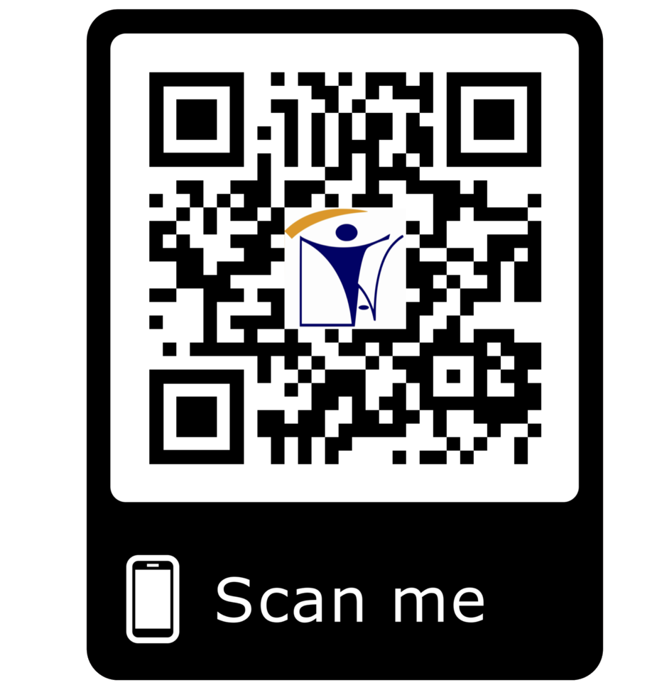



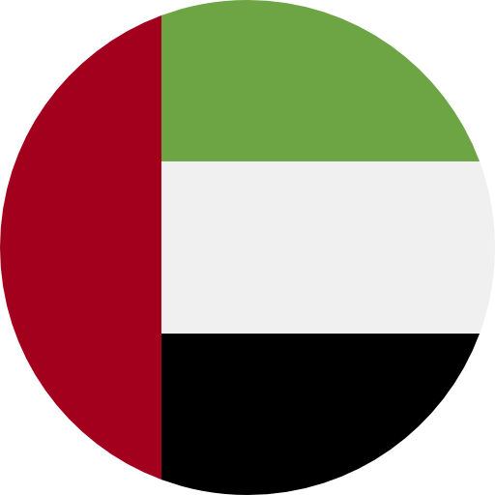



_{IT}IT_{S}@_{E}in_{R}a_{V}tt.c_{I}o_{C}m_{ES}
ERP MOBILE APP
DEVELOPMENT
WEB DEVELOPMENT
INAT GROUP OF COMPANIES
www.inatgroupofcompanies.com Since 1974
INAT SAUDI ARABIA
INAT ENGLAND
INAT BAHRAIN
INAT EMIRATE
INAT PHILIPPINES
INAT PAKISTAN
INAT NETHERLANDS
INAT International Agent Establishment
INAT UK Multinational LTD
INAT Corporate Europe Co. W.L.L
Business Tower, Floor 8,
INAT Hanayap Services
INAT International Agent Pvt. ltd
INAT Overseas Company B.V.
PO Box 30060, Al Khobar 31952
46 Cameron Road
Office 1309, Sitra Mall, Bldg No. 574,
Office # 811
Blk 30. Lot 16,
283 Zeenat Block,
Gustav Mahlerplein 2,
1/2
Eastern Province,
Ilford, Essex IG3 8LF
Road 31, Block 611.
Business Bay, Dubai,
Magdalene Ville 2, Bacolod City
Alama Iqbal Town, Lahore,
1082 MA, Amsterdam
Kingdom of Saudi Arabia info@inatt.com
United Kingdom info@inatukmultinational.com
Kingdom of Bahrain info@inatcorporateeurope.com
United Arab Emirates info@inatemirates.com
Philippines info@inatpacificasia.com
Islamic Republic of Pakistan info@inatpakistan.com
The Netherlands info@inatoverseascompany.com

Slide 2
IT SERVICES
INAT Suite of advanced business applications and IT Services have been evolving since 2006 and are well recognized across the globe. Conceived by a team of professionals focused on developing cost-efficient software solution, the INAT Suite today stands for a wide range of comprehensive, versatile IT solutions with short deployment cycles. We at INAT strives consistently to provide solutions and products using emerging technologies with high quality standards.
Track event across business locations
Significantly increase operational efficiencies
High Return on investment (ROI)
Cherry pick from the package of modular solutions to suite your company's needs today
Access and update information in real time
Employees can access relevant information in minutes
Facilitates data sharing across any number of office from a central location
Reasonably priced solution that is guaranteed to bring you the best return on investment
With the development time span of just 2 months, you can experience the benefits almost immediately
Specialized In:
Network Monitoring tools running on Linux platform. Using (Cacti,
ERP Module:
INAT is offering ERP based modules for different
Nagios, Smokeping)
industries by developing:
Desktop application using Visual Studio C# and SQL Server.
Vulnerability Assessment and Penetration test.
Website deployment using WordPress. (Content based).
Technical Support remote assistance running on OSX, Windows or
HR Module
Accounts / VAT Module
Testing Module
Purchasing Module
Linux desktop.
ERP
Mobile App Development
Web Development (WordPress, Joomla, Magneto etc.)
Internet Marketing Services (SEO, SEM, Leads Generation)
Telecommunication Items
Computer Supplies & Accessories
Calibration Module
Fleet Module
Inventory Module
Inspection Module
Fixed Assist Module
Web Based Solutions: We are offering smooth and seamless range of web-based solutions to add crisp factor for your online presence. Our developers are skilled enough to meet your expectations with regards to generate more leads and sales for your business. Rate on Investment is an important matter for all businesses, we know it and our state-of-the-art developers are offering top notch web-based services on different scales because we know how to exploit the powers of different technologies. We make sure that your website works 'responsively' on all devices.
"We are a reliable partner for companies who consider outsourcing web development. As a solid firm with 10 years of extensive experience within the global marketplace, ability to offer best turnaround for your projects. We take care of your business & marketing goals through our innovative and competitive business solutions."
Are you looking for a reliable and competitive Web Development Services? That's a great idea! Why? Because we are offering our range of quality services in areas of Web Development, Internet Marketing, Brand Recognition, Graphic Designing, App Development, Social Media Optimization, ERP Solutions and Software Development to meet your expectations. But you already knew that. That's why you're here, isn't it? We're more inexpensive than others, providing high-quality solutions for less money. Want to check out just how smart and competitive we are ? All you have to do is contact us.
Mobile App & Software Development:
Our services are not just confined to Web Based Solutions, but our Software Development Team is well informed and offering a wide range of Mobile App and Software Development options which allows our clients to experience a unique and exemplary custom mobile app & software solutions. With the core concept of business lead generation and to maximize the ROI for your business within this competitive world, our Android / iOS developers are skilled enough to develop enchanting and sleek Apps for your business.
Business lead generation is of a prime concern to gain maximum profitability. Keeping in view of this major business concept; our developers are skilled enough to develop enchanting mobile apps for your business. YES! You must immediately start thinking to develop Android / iOS app for your business to remain in contact with your customers. It is important to know the fact that:
*You are out of Business if you don't have a Prospect! *
Let's INAT be your business partner for making your dreams come true. Contact Us Today 2/2

