Slide 1
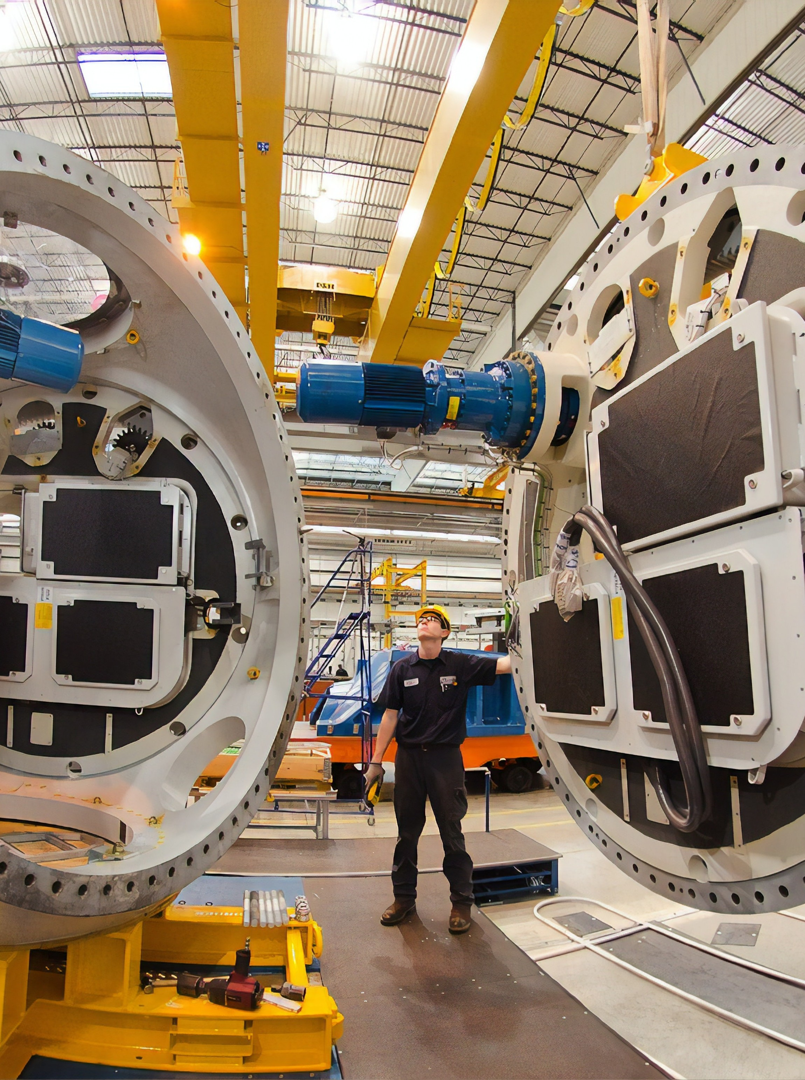






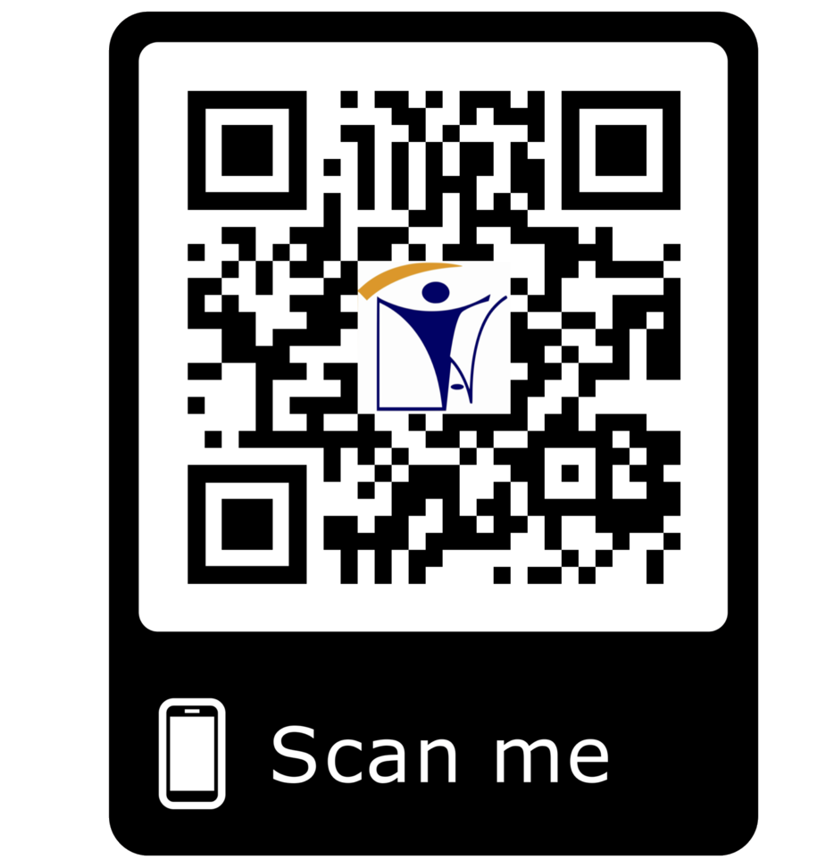







NDT@inatt.com NON DESTRUCTIVE AND DESTRUCTIVE TESTING
ISO 17020 Certified
CONVENTIONAL NDT INSPECTION SERVICES
ADVANCED NDT INSPECTION SERVICES
WPS, PQR & WELDER QUALIFICATION TEST SERVICES
ASNT LEVEL II & III TRAINING & CERTIFICATION
NDT LEVEL III CONSULTANCY
MECHANICAL AND DESTRUCTION TESTING
SUPPLY OF NDT EQUIPMENTS
INAT GROUP OF COMPANIES
www.inatgroupofcompanies.com Since 1974
INAT SAUDI ARABIA
INAT ENGLAND
INAT BAHRAIN
INAT EMIRATE
INAT PHILIPPINES
INAT PAKISTAN
INAT NETHERLANDS
INAT International Agent Establishment
INAT UK Multinational LTD
INAT Corporate Europe Co. W.L.L
Business Tower, Floor 8,
INAT Hanayap Services
INAT International Agent Pvt. ltd
INAT Overseas Company B.V.
1/4
PO Box 30060, Al Khobar 31952
46 Cameron Road
Office 1309, Sitra Mall, Bldg No. 574,
Office # 811
Blk 30. Lot 16,
283 Zeenat Block,
Gustav Mahlerplein 2,
Eastern Province,
Ilford, Essex IG3 8LF
Road 31, Block 611.
Business Bay, Dubai,
Magdalene Ville 2, Bacolod City
Alama Iqbal Town, Lahore,
1082 MA, Amsterdam
Kingdom of Saudi Arabia info@inatt.com
United Kingdom info@inatukmultinational.com
Kingdom of Bahrain info@inatcorporateeurope.com
United Arab Emirates info@inatemirates.com
Philippines info@inatpacificasia.com
Islamic Republic of Pakistan info@inatpakistan.com
The Netherlands info@inatoverseascompany.com

Slide 2
CONVENTIONAL NDT INSPECTION SERVICES
INAT offers the following NDT services (Conventional) to fulfill the needs of Oil & Petrochemical and Industrial operations.
ADVANCED NDT INSPECTION SERVICES
INAT offers the following NDT services (Advanced) to ful8il the needs of Oil & Petrochemical and Industrial operations.
Radiography Testing (RT)
Ultrasonic Testing(UT)
Magnetic Particle Testing (MPT/MT)
Ultra Sonic Thickness Gauging (UTG)
Liquid Penetrant Testing (LPT/PT)
Visual Testing ( VT)
Hardness Testing
Radiography Film Interpretation Services (RTFI)
Positive Material Identification (PMI)
Post Weld Heat Treatment (PWHT) Services
Phased Array Ultrasonic Testing ( PAUT)
Time Of Flight Diffraction Method ( TOFD)
Eddy Current Testing (ET)
Corrosion Mapping
Tank Inspection,
Plant Inspection during shut down by using NDT Method
API Inspection
WPS, PQR & WQT SERVICES
INAT provides the WPS, PQR and WQT services for all type of projects as per the codes, standards and speci8ications
CONVENTIONAL NDT INSPECTION SERVICES
RADIOGRAPHIC TESTING (RT)
This technique involves the use of
ULTRASONIC TESTING (UT)
Ultrasonic Inspection is a non-
MAGNETIC PARTICLE TESTING (MPT)
Magnetic Particle Inspection (MPI) is
penetrating Gamma or X-ray radiation
destructive testing method in which
used for the detection of surface and
to examine parts and products for
beams of high-frequency sound
near-surface flaws in ferromagnetic
imperfections. An X-ray machine or
waves are introduced into materials
materials. A magnetic field is applied to
radioactive isotope is used as a source of radiation. Radiation is directed through a part and onto 8ilm or other
for the detection of subsurface flaws in the material. The reflected beam is displayed and then analyzed to define
the specimen, using a permanent magnet (or ) electromagnet to detect imperfections in material, using the
media. The resulting shadowgraph
the presence and location of flaws or discontinuities.
following yokes and prods.
shows the internal soundness of the
i) AC Yoke
part. Possible imperfections are indicated as density variations in the film.
ULTRA SONIC THICKNESS GAUGING (UTG)
ii) AC/DC Yoke
PENETRANT TESTING (PT)
Apart from visual inspection this is
POSITIVE MATERIAL IDENTIFICATION (PMI)
Ultrasonic Thickness Gauging is a
probably the oldest and most widely
Positive Material Identification (PMI) is the
widely used non-destructive testing technique for measuring the thickness
used of all the NDT methods. It can
identification and analysis of various metal
of a material from one side. It is fast, reliable, and versatile, and unlike a
be used on any non-porous material.
alloys by their chemical composition
Its use is confined to the detection of surface breaking defects.
through non-destructive methods. PMI can be conducted on-site or in the
PMI helps our customers choose the right
micrometer or caliper it requires access
laboratory.
to only one side of the test piece. It will
give very accurate results in terms of
materials for their application from this
micrometer and, as per client requirements we can access the painted surfaces and cladding surfaces also.
HARDNESS TESTING
Hardness is the resistance of a material to localized
vast market .
RADIOGRAPHY FILM INTERPRETATION SERVICES (RTFI)
In addition to producing high quality radiographs, we are also
providing Radiography Film Interpretation Services ( RTFI)
deformation. The term can apply to deformation from
for clients as per their requirements, we also supply well
indentation, scratching, cutting or bending. In metals,
experienced RTFI Manpower to clients. Interpretation of
ceramics and most polymers, the deformation considered is
radiographs takes place in three basic steps:
(1) detection,
plastic deformation of the surface. We will provide all types of hardness measurements like
(2) interpretation, and
i) Brinell Hardness Testing
(3) evaluation.
All these steps make use of the radiographer's visual acuity.
Rockwell Hardness Testing
Vickers Microhardness
Visual acuity is the ability to resolve a spatial pattern in an
image.
2/4

Slide 3
ADVANCED NDT INSPECTION SERVICES
PHASED ARRAY ULTRASONIC TESTING (PAUT)
INAT provides Phased Array Ultrasonic Testing to inspect welds of process equipment, piping and structures (PAUT) offers very reliable detection and sizing capabilities along with a permanent record of ultrasonic inspection.
EDDY CURRENT TESTING (ET)
INAT provides complete Heat Exchanger inspection solutions for various tube materials by following methods.
Eddy Current Testing (ET) - for Non- Ferromagnetic Tubes.
IRIS (Internal Rotary Inspection System)
  Any material for accurate wall thickness.
Magnetic Flux Leakage Testing (MFLT)
  For Ferromagnetic and Fin fan Coolers Tubes.
Remote Field Eddy current Testing (RFT)
  For Ferromagnetic Tubes.
TIME OF FLIGHT DIFFRACTION (TOFD)
INAT provides Ultrasonic TOFD to inspect welds of process vessels and piping. TOFD is a reliable and fast advancing ultrasonic technique with good sizing capabilities and higher inspection speed.
CORROSION MAPPING
Corrosion mapping is a technique which maps material thickness using ultrasonic techniques. Variations in material thickness due to corrosion can be identified and graphically portrayed as an image. The technique is widely used in the oil
and gas industries for the in-service detection and characterization of corrosion in pipes and vessels. The data is stored on a computer and may be colour coded to show differences in thickness readings.
MECHANICAL AND DESTRUCTIVE TESTING
Hardness Testing ( Brinell, Vickers, Vickers Microhardness, Knoop)
Chemical Analysis
Bend Testing
Graphite Assessment
Corrosion Testing
Impact Testing
Proof Load Test
Shear Testing
Spring Testing
Fillet Break Tests
Nick Break Tests
WPS , PQR AND WQT SERVICES
Tensile and Compression Testing
Drop Weight Tear Testing
Fatigue Testing
Fracture Mechanics
The purpose of WPS is to determine that the welding operations proposed for fabrication can produce welds with required properties for intended application.
The purpose of PQR is to select material for specific application and to verify the weldment also meet the design criteria. INAT is providing PQR services from its own mechanical lab facility.
The objective of Welder Qualification Test to give maximum confidence that the welds mechanical and metallurgical properties meet the requirements of the applicable code/ specification.
INAT provides the following activities related to welding quality.
Preparing Welding Procedure Specifications(WPS) as per codes and standards.
Witnessing, Third Party Inspection of Welder Qualification Tests.
Preparing WPS, PQR & WPQ
Analysis of Mechanical and Metallurgical Tests.
Carrying out NDT Inspection Tests ( UT,RT, MT,PT, VT, etc.)
Training of Welders on various Welding Processes.
3/4

Slide 4
SUPPLY OF NDT EQUIPMENTS (Authorized Rep from America Europe & China Companies)
Sales & Supplies division of 'INAT NDT' is catering to needy customers and industries by supplying high quality NDT Equipment, Accessories and consumables that meet international codes, specifications and standards. Currently we sell and supply all types of NDT equipment, which include the following:
LPT/MPT CONSUMABLES
MPT EQUIPMENTS RT ACCESSORIES UT ACCESSORIES
Corrosion Scanner, Tank Floor Scanner
UT (UT Flaw Detector, UT thickness , Pocket UT)
Advance UT (PAUT, TOFD Equipment’s, Bracelet Chain PAUT)
Phase Array Crawler scanner, Wheel probe/Transducer
PAUT Chain Scanner, Cobra chain scanner, Immersible concave phase
array probe, Portable Handheld Probe,
Multifunction automatic piping scanner probe for large pipes, Automatic scanner for tank probe, small piping scanner,
Different type of Probes (Normal Beam, Protective face, High frequency delay line, Dual element, Angle Beam, TOFD, TOFD with
Wedge TRL, Guide Wave, Surface Wave, Spot weld, 1T/3R steel plate
inspection, Micro Angle Mean, Immersion, Aviation Special, Railroad
special, Special Dual Element, Hollow shaft, High Temperature,
Creeping Wave, Pen Type, high temperature),
Different type of Housing, Different type of Connector, different type
of Wedge, Calibration blocks,
Corrosion Scanners Tools,
Tanks Inspection Tools
Intelligent Calibration Portable Digital Ultrasonic flaw detector
ASNT LEVEL I & LEVEL II TRAINING & CERTIFICATION & LEVEL III TRAINING
We provide ASNT Level I & Level II Training and Certification & Level III Training to internationally recognized certification scheme and employer based scheme as per ASNT, SNT –TC-1A & ANSI/ASNT CP-189. With our well experienced and qualified ASNT Level III persons, we also provide in-house NDT Training tailored to meet client requirements, in the following methods.
CONVENTIONAL NDT TRAINING
Radiography Testing (RT)
Ultrasonic Testing ( UT)
Magnetic Particle Testing ( MPT)
Liquid Penetrant Testing ( LPT)
Visual Testing (VT)
UT of TKY Joints
Radiographic Test Film Interpretation (RTFI)
Ultrasonic Thickness Gauging (UTG)
ADVANCED NDT & OTHER TRAINING
Phased Array Ultrasonic Testing (PAUT)
Time-of-Flight Diffraction (TOFD)
Eddy Current testing (ET)
Tanks Inspection
Forklift operators,
Welders in all positions
Crane operators
CNC operations
NDT LEVEL III CONSULTING SERVICES
Selection of right nondestructive testing methods and techniques suitable for the application.
Preparation of written practices as per ASNT Recommended practice SNT-TC-1A .
Training and certification of personnel as per employer's written practice.
Preparation of procedures based on International, National or In-house Codes, Standards and specifications to meet customer requirements.
Procedure preparation for NDT methods such as Magnetic Particle Testing (MPT), Ultrasonic testing (UT),
Liquid Penetrant Testing(PT), Radiographic Testing, Positive Material Identi8ication (PMI) and Hardness Testing.
Review of procedures based on International, National or in-house Standards & Speci8ications
TRAINING PROGRAMS IN WELDING & WELDERS CERTIFICATION
We are providing Welding Training Programs in all Welding Processes ( Ex. SMAW, TIG, MIG., etc.) at client’s facility as per the standards and codes like ASME SEC IX (Boiler and Pressure Vessel Code), AWS D1.1 (Structural Welding Code of Steels) , AWS D1.2 (Structural Welding Code of Aluminium), etc. also certify welder qualifying as
per Saudi Aramco requirements
4/4

