Slide 1
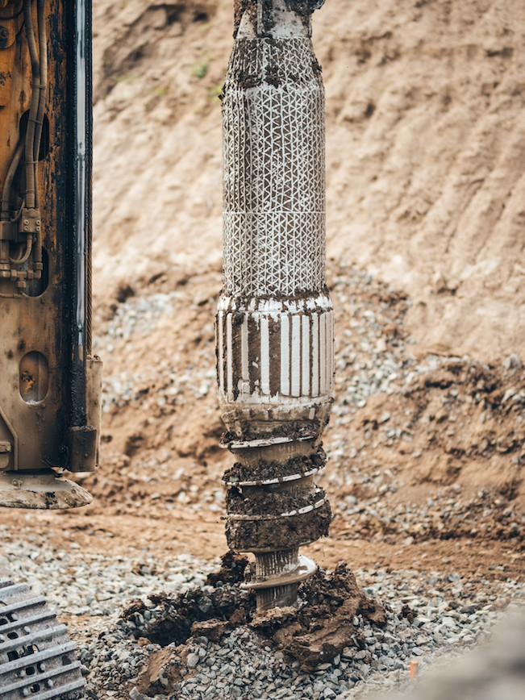





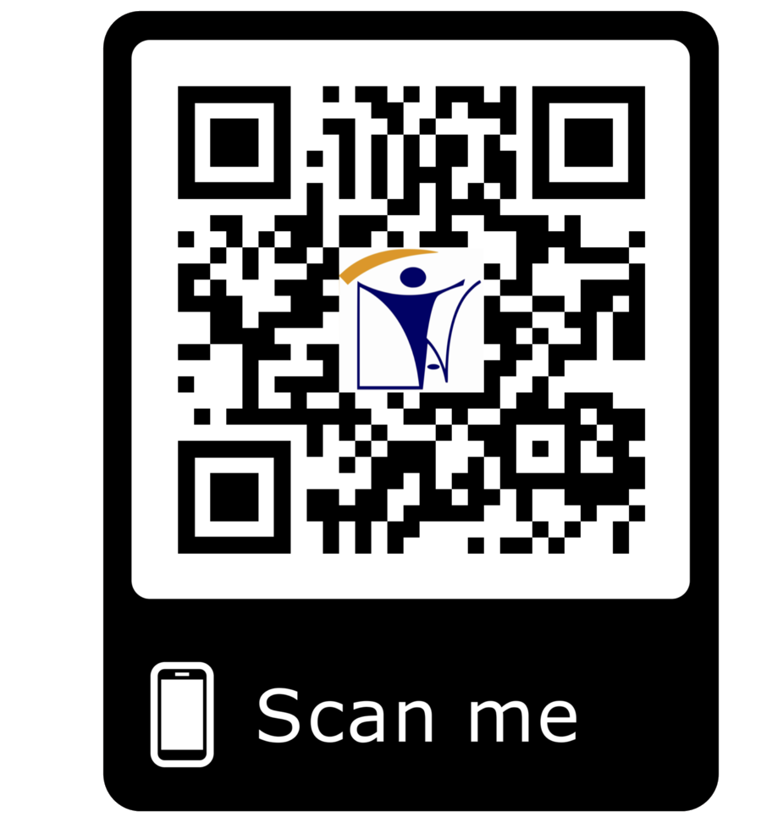







te_{T}sti_{E}ng_{S}@_{T}in_{I}a_{N}tt._{G}com
17025 Accredited
CIVIL TESTING SERVICES
GEOTECHNICAL INVESTIGATIONS
GEOPHYSICAL STUDIES AND TESTING
CALIBRATION SERVICES
ENVIRONMENTAL STUDIES AND TESTING
INAT GROUP OF COMPANIES
www.inatgroupofcompanies.com Since 1974
INAT SAUDI ARABIA
INAT ENGLAND
INAT BAHRAIN
INAT EMIRATE
INAT PHILIPPINES
INAT PAKISTAN
INAT NETHERLANDS
INAT International Agent Establishment
INAT UK Multinational LTD
INAT Corporate Europe Co. W.L.L
Business Tower, Floor 8,
INAT Hanayap Services
INAT International Agent Pvt. ltd
INAT Overseas Company B.V.
PO Box 30060, Al Khobar 31952
46 Cameron Road
Office 1309, Sitra Mall, Bldg No. 574,
Office # 811
Blk 30. Lot 16,
283 Zeenat Block,
Gustav Mahlerplein 2,
1/4
Eastern Province,
Ilford, Essex IG3 8LF
Road 31, Block 611.
Business Bay, Dubai,
Magdalene Ville 2, Bacolod City
Alama Iqbal Town, Lahore,
1082 MA, Amsterdam
Kingdom of Saudi Arabia info@inatt.com
United Kingdom info@inatukmultinational.com
Kingdom of Bahrain info@inatcorporateeurope.com
United Arab Emirates info@inatemirates.com
Philippines info@inatpacificasia.com
Islamic Republic of Pakistan info@inatpakistan.com
The Netherlands info@inatoverseascompany.com

Slide 2
CIVIL TESTING SERVICES
New Technologies have increased construction liability and revised building standards have made quality testing integral to the successful completion of today’s construction projects. that is why quality testing is consider most important for the successful project completion and increase reliability
“INAT” 17025 Accredited Testing Laboratory Services offering wide range of Civil Testing Services performed by our highly qualified testing engineers, technicians with most of there background from civil and geology, backed by documentation needed to ensure that our customer meets all the defined requirements and Standards. Our tests are conducted in accordance with the both National and International Standards.
Our Main Services include but not limited to:
Soil Testing
Aggregate Testing
Concrete Testing
Cement Testing
Asphalt and Binder Testing
Chemical & Water Testing
Petro graphic Analysis
Rock and Rock Foundation Testing
Mortar Testing
Bitumen Testing
Superpave testing,
Field Testing by NDG
Field Testing by Electrical Density Gauge
Pavement Investigation
Asphalt Mix Design
Other special test based on client requirements
Concrete Structure Inspection and failure assessment
Structural Integrity , defect and voids in concrete & rock
Durability Assessment of Reinforced concrete Structure
NDT Compression test by Schmidt Hammer
NDT by Pulse Velocity for concrete
Core Drilling
Steel Rebar Testing
Rebar Locator & cover distance measurement
Pull off Test
Concrete coating Thickness measurement
Concrete Mix Design
Structure and Foundation Testing
Brick & Block Testing
Site Investigation
Our technical staff contribute to diversify their skills from material testing to Analytical Chemistry, with backgrounds stemming from Soil Investigations, Geological Survey, Geophysical Survey, Testing of Soil, Aggregate, Concrete, Asphalt, Environmental Survey and others.
Technical Consultancy Scope of services includes:
Design and implementation of quality control programs.
Supply of testing equipment, logistics, staff and management of site laboratories.
On site materials testing
Preparation of periodic quality control and statistical analysis reports.
Design and implementation of quality control programs for manufacturing facilities such as:
Ready mix concrete plants
Asphalt production plants
Precast unit plants
Blocks and tiles factories
Concrete additives manufacturing plants
Building materials factories
Evaluation of materials quality utilizing statistical techniques
Ability to establish Site/ Mobile Laboratory
INAT maintains several sets of laboratory equipment and logistics in order to establish site/ mobile laboratories along with Inspection and Testing of varying size, scope and capacity, whenever requested. Our Technical Staff is ready to mobilize to any location with Our Mobile Laboratory.
Training for Civil Testing Laboratory and Geotechnical Staff
Conducting training courses and seminars for:
Laboratory Technician
Laboratory Supervisor
Geotechnical Investigation and others
CPT by Seismic Cone
2/4

Slide 3
GEOTECHNICAL INVESTIGATIONS
INAT Group 17025 Accredited providing geotechnical investigation services both Onshore and offshore drilling ranging from cone penetration testing (CPT), to conventional drilling techniques, sampling and borehole testing, geological mapping, geophysical methods and other require methods to acquires geotechnical and other data to characterize the subsurface. Data is collected using a variety of methods, tools, sensors and Laboratory tests.
INAT site and geotechnical investigation services consist of:
Consultation on special geotechnical studies
Onshore and offshore drilling
Soil and rock laboratory testing
Geotechnical studies for dams, roads, buildings and retaining structures
Geological surveys including geological and geotechnical mapping
Geotechnical and structural
Measurement of pore water pressure and groundwater level
Measurement of settlement
Measurement of ground movement
Measurement of pressure/ stress and strain
Investigation, monitoring and analysis for slope stability
GEOPHYSICAL STUDIES AND TESTING
Prospecting studies for mining and construction materials
Research programs and training courses
Interpretive reporting of field and laboratory test results
Hydrological studies
Other Geotechnical Services
CPT by Insitu Vane and Seismic Cone
Cone Penetration Test (Manual)
Pressure meter Test
Plate Bearing Test
Down Hole Shear wave Velocity Test
INAT Group 17025 Accredited providing offers onshore and near shore geophysical services for investigating the ground both on surface as well as borehole, geophysical surveys are provided where the latest techniques and advanced analysis software are employed for data acquisition, processing and interpretation of results. Our Modern equipment and skilled staff are readily available to meet the client’s needs and expectations effectively and in a timely manner.
The scope of services of the Geophysical Studies includes:
Surface seismic survey
Seismic refraction
Seismic refraction tomography (SRT)
Multi-channel analysis of surface waves (MASW).
Spectral analysis of surface waves
Electrical & Thermal survey
Electrical resistivity tomography (ERT – 2D & 3D)
Vertical electrical sounding (VES)
Spontaneous/Self Potential (SP)
Shallow direct – current (DC)
electrical resistivity sounding
Induced polarization (IP)
Thermal resistivity
Other local specialist services include
Ground Penetrating Radar (GPR)
Electromagnetic Survey (EM)
Thermal imaging
Gravity surveys
Standard borehole logging methods
Three-arm caliper logging
Temperature conductivity logging
Natural gamma logging
Gamma – gamma (density) logging
Impeller flow meter logging
Electric logging
Borehole seismic survey
Full wave sonic logging
Down-hole seismic test
P&S wave suspension logging
Cross-hole seismic test
Cross-hole seismic tomography
Seismic cone penetration test
Marine Geophysical & Oceanographic Investigation
Bathymetry
Sonar Imaging
Sub Bottom Profiling
Oceanographic Surveying
Underwater Services,
3/4

Slide 4
PILE TESTING SERVICES
Pile Testing Instrumentation
INAT offering Services in pile quality control and testing and general geotechnical instrumentation. INAT providing a range of testing, monitoring services prior to, during and after construction of piles for both Onshore and Offshore
The scope of services of the Pile Testing & Instrumentation includes:
Low strain integrity testing
High strain dynamic testing
Cross hole sonic logging
Caliper logging testing
Static pile load testing
Instrumented pile load testing
Instrumentation of driven piles
PDM Pile Test and Deflection Monitoring
ENVIRONMENTAL STUDIES AND TESTING
INAT provides an array of professional environmental sampling and testing services that comply with the most stringent regulatory requirements in the environmental industry.
INAT environmental studies and testing scope of services includes:
Environmental baseline surveys
Environmental impact assessment studies
Environmental and water studies in areas of groundwater, surface water, dams and soil
Green building assessment studies
Investigation of potentially contaminated sites for the extent of contamination of land and ground water for the purpose of environmental baseline/environmental impact studies
Drilling of boreholes by various drilling techniques and installation of piezometers
LNAPL interface measurement
Environmental sampling of soils and ground water
In-situ VOC screening, water analysis and gas measurement
Laboratory analysis of encountered samples for complete suite of environmental contaminants
Preparation of reports by using different data presentation methods, including AGS
Control of quality of drinking water
Testing for environmental discharge permits of wastewater, recycled water, hazardous waste and industrial waste
Testing of soils for agricultural & landscaping purposes and water for suitability for irrigation
Characterization of indoor air quality and evaluation of human exposure concerns
Noise surveys
CHEMICAL AND WATER TESTING
Our testing services covers Drinking Water, Seawater, Groundwater, Surface & Soils Sediments, Solids, Cements which includes:
Physical properties
Inorganic analysis –metals, inorganic nonmetallic constituents
Organic analysis- individual compounds (TPH, VOC, SVOC, PAH, PCB, etc.)
Organic analysis- aggregate organic constituents (TOC, BOD, COD, etc.)
Microbiological analysis.
Wet Chemistry (pH, EC, Turbidity, TKN, Ammonia, Cyanide, BOD, COD, TSS, TDS, etc.)
Trace Metals (Fe, Cu, Mn, Cr, Cd, Ag, Pb, Al, Zn, etc.)
4/4

