Slide 1





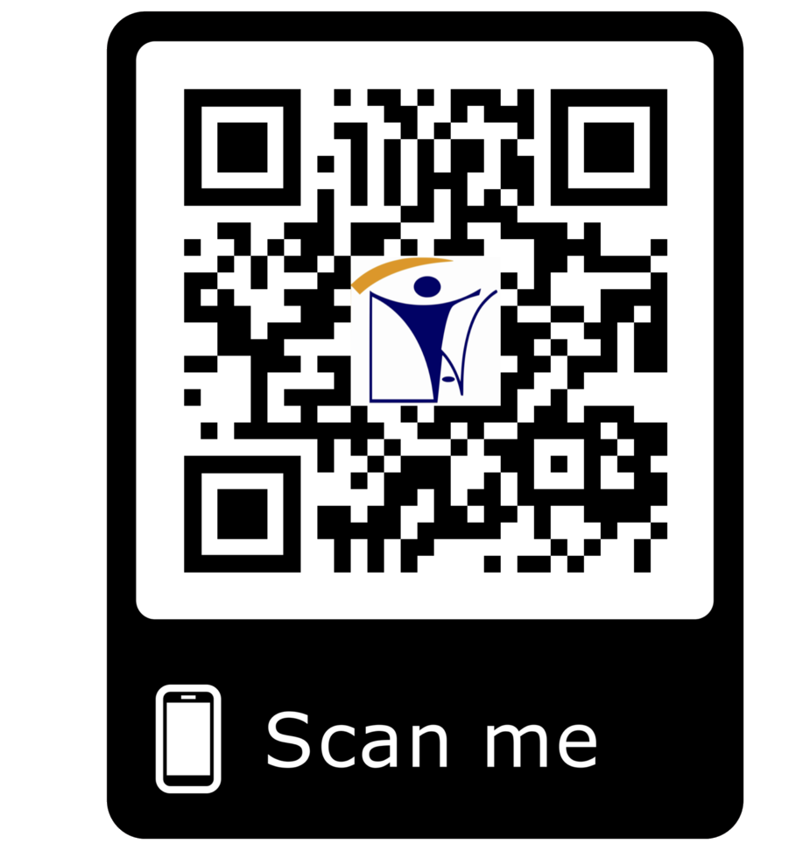







training@inatt.com
TRAINING
ISO IRCA CERTIFIED TRAININGS COURSES
PROJECT MANAGEMENT & LEAN SIX SIGMA COURSES
TRAINING, PREPAPATION FOR CERTIFICATION
ASNT LEVEL I & II & III TRAINING & CERTIFICATION
PERSONNEL CERTIFICAION AS PER ISO 17024
INAT GROUP OF COMPANIES
www.inatgroupofcompanies.com since 1974
INAT SAUDI ARABIA
INAT ENGLAND
INAT BAHRAIN
INAT EMIRATE
INAT PHILIPPINES
INAT PAKISTAN
INAT NETHERLANDS
INAT International Agent Establishment
INAT UK Multinational LTD
INAT Corporate Europe Co. W.L.L
Business Tower, Floor 8,
INAT Hanayap Services
INAT International Agent Pvt. ltd
INAT Overseas Company B.V.
1/4
PO Box 30060, Al Khobar 31952
46 Cameron Road
Office 1309, Sitra Mall, Bldg No. 574,
Office # 811
Blk 30. Lot 16,
283 Zeenat Block,
Gustav Mahlerplein 2,
Eastern Province,
Ilford, Essex IG3 8LF
Road 31, Block 611.
Business Bay, Dubai,
Magdalene Ville 2, Bacolod City
Alama Iqbal Town, Lahore,
1082 MA, Amsterdam
Kingdom of Saudi Arabia info@inatt.com
United Kingdom info@inatukmultinational.com
Kingdom of Bahrain info@inatcorporateeurope.com
United Arab Emirates info@inatemirates.com
Philippines info@inatpacificasia.com
Islamic Republic of Pakistan info@inatpakistan.com
The Netherlands info@inatoverseascompany.com

Slide 2
ISO Certified Courses, Project Management Courses, ASNT Courses & Personnel Certification
ISO IRCA Certified Courses
ISO 9001 Foundation Training Course
This one-day course provides a detailed review of ISO
ISO 9001 foundation & Implementation of ISO 9001
This two-day course provides a detailed understanding of the concepts and focus of the ISO 9001:2015 standard and
9001:2015 include understanding of standard and benefits
that implementing ISO 9001 can bring.
ISO 9001:2015 Auditor Transition Training & Individual certification
provides the knowledge necessary to effectively implement an ISO 9001 quality management system.
ISO 9001:2015 Internal Auditor Training
This dynamic and interactive three-day course provides a
This IRCA Certified QMS ISO 9001:2015 Auditor Transition
foundation on the ISO 9001:2015 standard, the ability to
training course is a two-day transition course meant to
interpret and implement requirements and through workshops and case studies provides the skills and techniques needed to
transition auditors experienced in the 9001 standard to the
new 2015 revision. This course uses exercises, workshops, role playing and case studies to teach the concepts.
measure the effectiveness of a quality management system through an internal audit.
ISO 9001: 2015 Lead Auditor Training and Individual Certification
IRCA Certified QMS ISO 9001:2015 Lead Auditor training course is one of the most widely recognized courses around the
world, five-day course focuses on effective auditing of quality management systems against the ISO 9001:2015 standard and
includes; planning and preparation of audits, audit techniques and audit reporting.
ISO 14001 Foundation Training & Implementation
This two-day course provides a detailed understanding of the ISO 14001:2015 standard and the knowledge and skills necessary to effectively implement an ISO 14001 environmental management system.
ISO 14001: 2015 Internal Auditor Training
This beginner-level course was developed to teach EMS internal auditing skills and knowledge of the new standard. No prior experience or knowledge of the standard is needed, you will learn it all here!
ISO 14001:2015 EMS Lead Auditor Training
IRCA Certified EMS ISO 14001:2015 Lead Auditor is one of the most widely recognized courses in our industry. This five-day
course focuses on effective auditing of environmental management systems against the ISO 14001:2015 standard, planning
and preparation of audits, audit techniques, and audit reporting.
ISO 14001:2015 EMS Auditor Transition Training & Certification
This IRCA Certified EMS ISO 14001:2015 Auditor Transition is a two-day transition class meant for experienced EMS Lead
Auditors in the 14001:2004 standard to train and transition them into the new 2015 revision of the standard. This course
focuses mainly on the changes and interpretations for the revised standard.
ISO 45001:2018 Occupational Health and Safety Management Systems Training Courses
INAT Training offers a range of ISO 45001 Occupational Health and Safety Management Systems training courses, including
an ISO 45001 Internal Auditor training course and an IRCA-accredited Lead Auditor course. These Training courses have
been developed for all learning styles and are taught by industry leading subject matter experts.
ISO 45001:2018 Awareness
On day course on detailed understanding of the key terms, definitions and requirements of ISO 45001 and how the standard can help your organization to better meet customer needs.
Foundation& Implementation of ISO 45001:2018
This two-day course provides a detailed understanding of the ISO 45001 standard and the knowledge and skills necessary to effectively implement an ISO 45001 Occupational health and safety management system.
ISO 45001:2018 Internal Auditor Training
This two-day course provides a solid foundation on the OHSAS 18001 standard, the ability to interpret and implement
requirements, plus the skills and techniques to measure the effectiveness of an occupational health and safety management
system through an internal audit.
ISO 45001:2018 Auditor Conversion Training
IRCA-certified three-day course is designed for experienced management systems auditors seeking to add Occupational Health & Safety Management Systems auditing to their credentials Conversion from OHSAS 18001:2007.
2/4

Slide 3
ISO 45001:2018 IRCA Lead Auditor Training
IRCA-accredited OHSAS 18001:2007 Lead Auditor course is one of the most widely recognized courses in our industry. This five-day course focuses on effective auditing of occupational health and safety management systems against the OHSAS 18001 standard, planning and preparation of audits, audit techniques, and audit reporting.
ISO 22000 Food Safety Management Systems Training
We offer ISO 22000 courses as below
ISO 27001 Information Security Management Systems (ISMS) Training Courses
Foundation & Internal Auditor
Training courses have been developed for all learning styles
Lead Auditor Training and are taught by industry leading subject matter experts.
ISO 27001 Internal Auditor Training & Understanding & Implementation
This three-day course provides a solid foundation on the ISO 27001 standard, the ability to interpret and implement requirements, and the skills and techniques to measure the effectiveness of an information.
ISO 27001 IRCA ISMS Lead Auditor Training
IRCA-accredited ISMS ISO 27001 five-day course focuses on effective auditing of information security management systems against the ISO 27001 standard, planning and preparation of audits, audit techniques, and audit reporting.
ISO 22301 Certified Lead Auditor Courses
ISO 22301 Internal Auditor Training & Understanding & Implementation
This three-day course provides a solid foundation on the ISO 22301 standard, the ability to interpret and implement requirements, and the skills and techniques to measure the effectiveness of an information.
ISO 22301 IRCA ISMS Lead Auditor Training
IRCA-accredited five-day course focuses on effective auditing of Business Continuity Management System (BCMS) based on ISO 22301, planning and preparation of audits, audit techniques, and audit reporting.
ISO 50001 Energy Management Systems Training Courses
Training offers a range of ISO 50001 Energy Management Systems (EnMS) training courses, including:
ISO50001 Internal Auditor Training
This three-day course provides a solid foundation on
ISO 50001 IRCA Lead Auditor Training
This five-day course focuses on effective auditing of
the ISO 50001 standard, the ability to interpret and
energy management systems against the ISO 50001
implement requirements, and the skills and techniques to measure the effectiveness of an energy management
standard, planning and preparation of audits, audit techniques, and audit reporting.
system through an internal audit.
Project Management Professional & Certified Lean Six Sigma
Project Management Courses
Project Management Professional
Lean Six Sigma Certified Courses
Certified Black Belt
Professional in Business Analysis
Certified Green Belt
Risk Management Professional
One-year Quality Manager Diploma
Personnel Certification as per ISO 17024
Personnel Certification
INAT Offering personal certification in the field of:
Certified Yellow Belt
Certified Concrete Technician
Certified Asphalt Technician
Certified Soil & Aggregate Technician
Certified Chemical Technician
Certifies Laboratory Supervisor
Certified Geotechnical Supervisor
Certified CPT operator
Certified Drilling Technician
Certified Mechanical Technician
Certified Instrumentation Technician
Certified Vendor Inspector (Mechanical)
Certified Vendor Inspector (Electrical)
Certified Quality Control Procurement Supervisor/ Manager
Certified Calibration Inspector Force/Torques
Certified Calibration Inspector Dimensional
Certified Calibration Inspector Temperature
Certified Calibration Inspector Analytical
Certified Calibration Inspector Pressure
Certified Calibration Inspector Electrical
Certified Calibration Inspector Instrumentation
3/4

Slide 4
INAT is committed to providing most effective training with the expertise gained over the past few years in the inspection of power stations, pressure vessels, structures, engineering components, pipe systems, storage tanks and aerospace components. Our course structure is designed to provide custom training programs, best practices leading to gaining thorough knowledge in practical Non-destructive testing.
TRAINING, PREPARATION AND CERTIFICATION
API 510 Pressure Vessel, API 570 Piping , API 653 Tanks and API 580 Risk Assessment Preparatory Courses
American Welding Society( AWS)- Welding Inspector Preparatory Courses
Welding Inspector Certification Courses-TWI-CSWIP 3.1& Senior Welding Inspector as per 3.2
Painting And Coating Inspector Courses (BGAS & NACE)
Third Party Vendor Inspection Courses (Mechanical & Electrical)
ASNT Level 3 Preparation Courses in All The Methods
Radiation Safety Officer Preparatory Courses (RSO)
Radiation Safety course for Industrial NDT Technicians,
Radiation Safety course for NDG Technicians,
Plant & Inservice Inspection course
Welding Procedure Specification (WPS) & Welder Qualification Tests (WQT) Preparation Courses,
NACE Corrosion Engineer Preparation Course,
Railway Line Inspection Techniques
ASNT LEVEL I & LEVEL II TRAINING & CERTIFICATION
We provide NDT Training and Certification to internationally recognized certification scheme and employer based scheme as per ASNT SNT –TC-1A and ANSI/ASNT CP-189. With our well experienced and qualified ASNT Level III instructors, we also provide in-house NDT Training Tailored to meet client requirements, in the following methods.
CONVENTIONAL NDT TRAINING
Radiography Testing (RT)
Ultrasonic Testing ( UT)
Magnetic Particle Testing ( MPT)
Liquid Penetrant Testing ( LPT)
Visual Testing (VT)
UT of TKY Joints ( Ultrasonic Testing of T, K,Y joints)
Radiographic Testing Film Interpretation (RTFI)
Ultrasonic Thickness Gauging (UTG)
CONVENTIONAL NDT TRAINING
Phased Array Ultrasonic Testing (PAUT)
Time-of-Flight Diffraction (TOFD)
Eddy Current Testing (ET)
Course Contents
Presentation of theory is easy, but the development of a top performing technician, professional or supervisor is not. This step requires a thorough knowledge of the industry and an understanding of the problems faced by the people who make the industry work. Keeping in view, our Course Contents are designed and developed more on practical aspects of NDT.
ASNT LEVEL I & II TRAINING PARTICIPANTS BASE
Our participants come from wide range of industries including Oil & Gas, Chemical, Aerospace, Automotive, Energy, Inspection Companies, Power, Rail & Research laboratories.
Also included are the international participants from Middle East countries, Malaysia, Europe, Bhutan, Nepal, Pakistan and India.
INAT EXAMINATIONS PROCESS
The examination will be in accordance with required standards
Candidates should plan to arrive at the examination site at least 30 minutes prior to the scheduled examinations.
No one will be admitted after an examination has started. Candidates will receive results within a week after the exam. For some it take up to 30 days
For Personnel certification related training courses, candidates will receive their certificates 1 week after the exam.
Candidates who fail to achieve a passing score will be required to sit for the exam again.
4/4

